Slide 1
Flutter Stateful Widgets
DMIT 2504 Week 4 day 1

Slide 2





Announcements
Notes:
- Assignment 1 marks coming this week
Assignment 2 due next week Friday
Do you like the slides or would you prefer going straight into examples?

Slide 3
Expectations
No Late Assignments
No Cheating
Be a good classmate
Don’t go to stupid sites in class
Show up to class

Slide 4
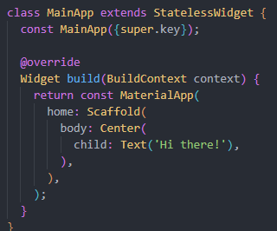
Recap: Stateless Widgets
Nearly everything in flutter is a widget
Widgets without state are created and stay the way they are
Widgets need to override the build function and return a Widget

Slide 5
What if I need to store and respond to some state?
Say I want to track how often a button has been pressed and update a visual counter
I need some sense of state to track button presses
Any time the state changes I need to redraw the counter
I don’t want to redraw my entire app if I don’t have to
Flutter can handle all of these requirements with Stateful widgets

Slide 6
Parts of a stateful Widget
The Widget
extends the StatefulWidget class
Overrides the createState() function
Contains the constructor
The State
extends the State class
Overrides the build() function
Overrides the initState() function
Contains all state properties
Allows the setState() function

Slide 7
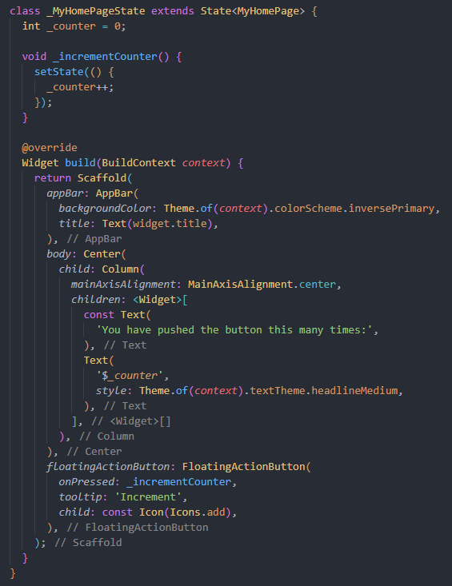
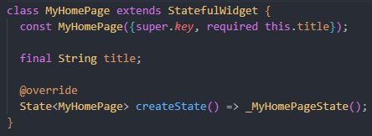
The code
The state variables
Updating the state
This is the state part
using the state
This is the Widget part
Linking the widget to
its state
Function that updates
the state
Notes:
Explain tree structure, draw it out on the board

Slide 8
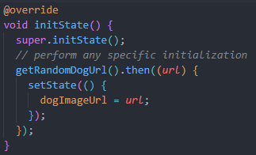
Initializing state
Initializing state can be done in 2 ways
First you can simply set the values when you create them
If your state initialization relies on the location of the widget in the tree or some other source of information you can initialize with initState()

